Slide 1
The battle of neighborhoods
Prospects of a Indian Restaurant in Toronto, Canada
For hsb India (p) ltd

Slide 2

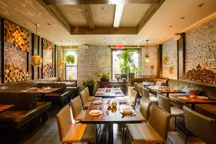
Description of the Problem
A restaurant is a business which prepares and serves food and drink to customers.
Owning a restaurant …
Has fair share of responsibilities that require you to be on your feet
Needs an accessible location
A theme or style that appeals to a broad range of customers
A solid menu
First move is very important, thereby choice of location is very important.
HSB India (P) Ltd., plan to choose the correct location to start its first restaurant in Toronto, Canada.

Slide 3

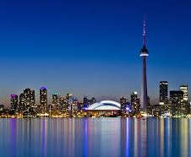
Prospects of a Indian Restaurant in Toronto, Canada
Toronto, Canada's largest city is consistently rated among the world’s top most liveable cities.
Toronto boasts …
a multicultural population
diverse neighborhoods
world class cultural attractions,
Entertainment
dining and shopping
As it is highly developed city so cost of doing business is also one of the highest. Thus, any new business venture or expansion needs to be analyzed carefully.
Help in reduction of risk and the Return on Investment will be reasonable.

Slide 4
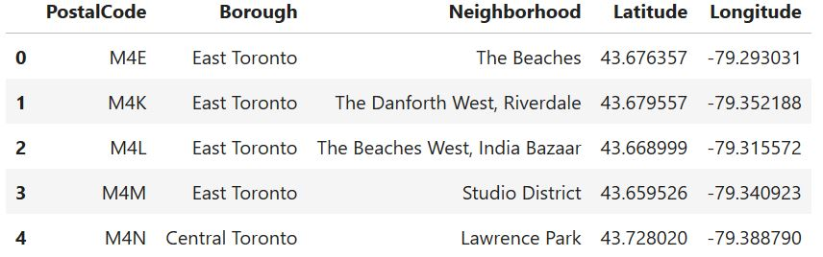
Data required for exploratory analysis
Neighborhood has a total of 11 boroughs and 103 neighborhoods. In order to segement the neighborhoods and explore them, we will essentially need a dataset that contains the 11 boroughs and the neighborhoods that exist in each borough as well as the latitude and logitude coordinates of each neighborhood.
Wikipedia page (https://en.wikipedia.org/wiki/List_of_postal_codes_of_Canada:_M) has Postal codes beginning with M are located within the City of Toronto in the province of Ontario.
Latitude and Longitude (the geographical coordinates) of each postal code accessed from http://cocl.us/Geospatial_data
The initial Dataset is as depicted →

Slide 5
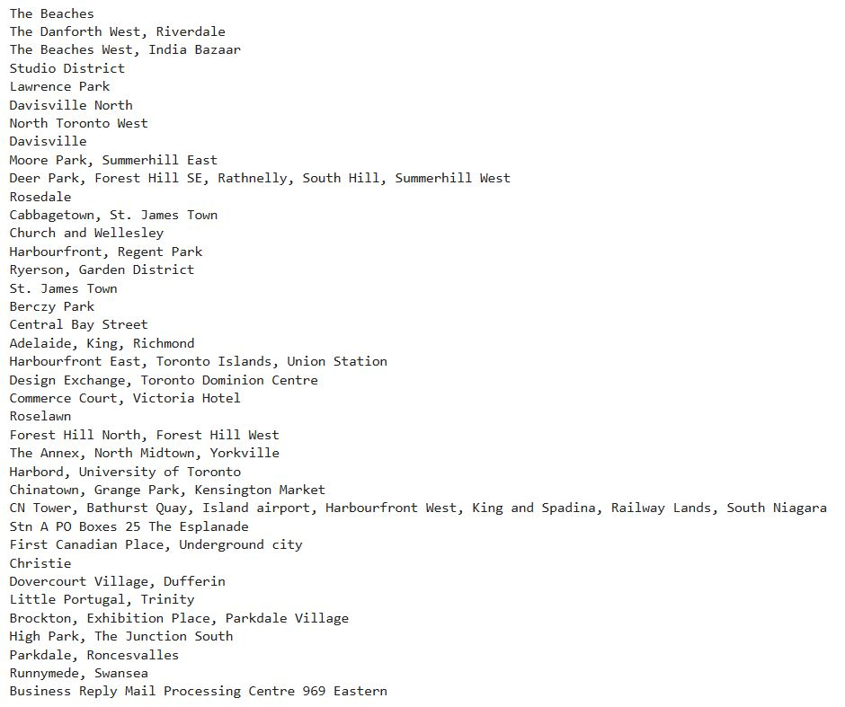
Exploratory analysis
Nearby Venues
The geographical coordinate of Toronto City are 43.653963, -79.387207 is obtained with an instance of geopy geocoder.
The Foursquare API will be used to obtain the venues for the geographical location data. These will be used to explore the neighborhoods of Toronto accordingly.
1. Create the get request url (Foursquare ID and Secret are necessary)
a. Number of Venues we will look for is 100
b. Radius of Search Would be 0.5 km.
2. Create a json from the request object (using requests Module)
3. Create the lists containing the information
4. Create the dataframe from the list.

Slide 6

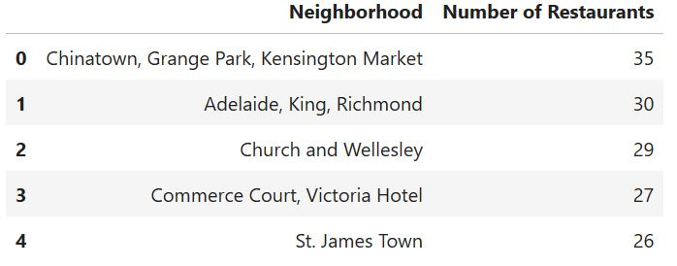
top 5 neighborhoods of Toronto City thost has the maximum number of restaurants

Slide 7
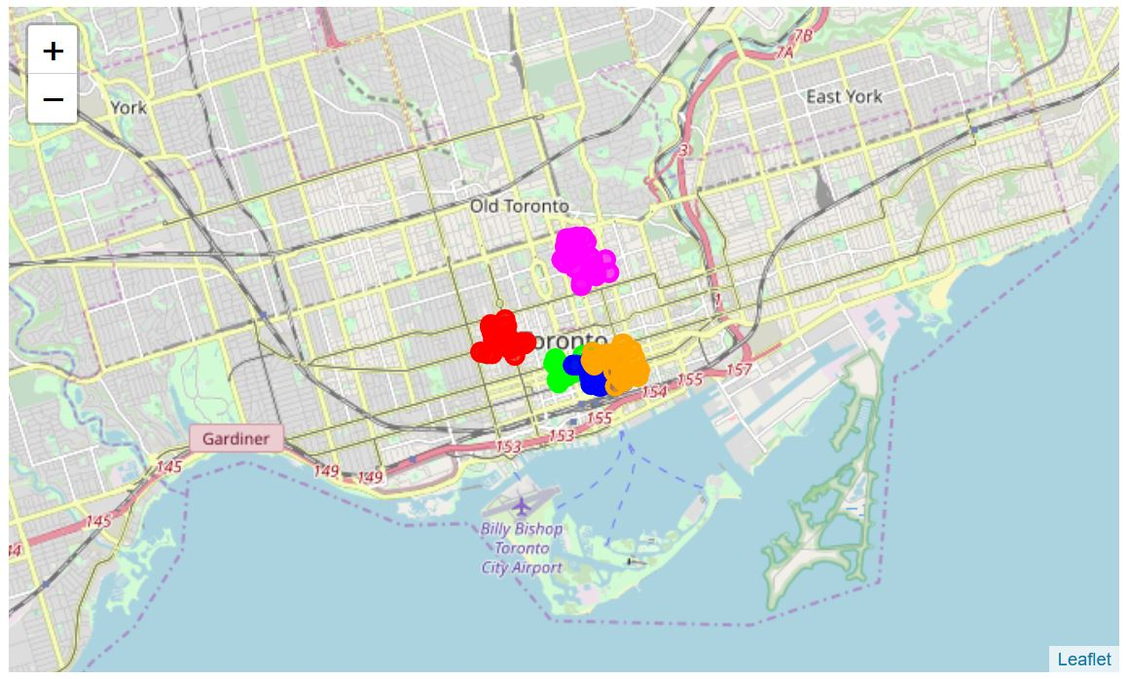
Visualization of top 5 neighborhoods

Slide 8
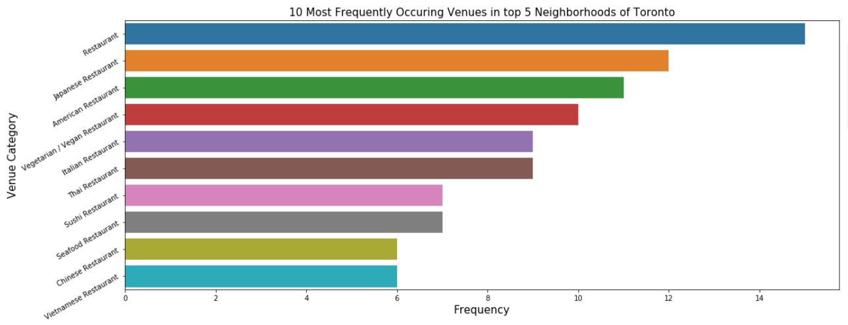
the 10 most frequent restaurant venues in the top 5 neighborhoods.

Slide 9
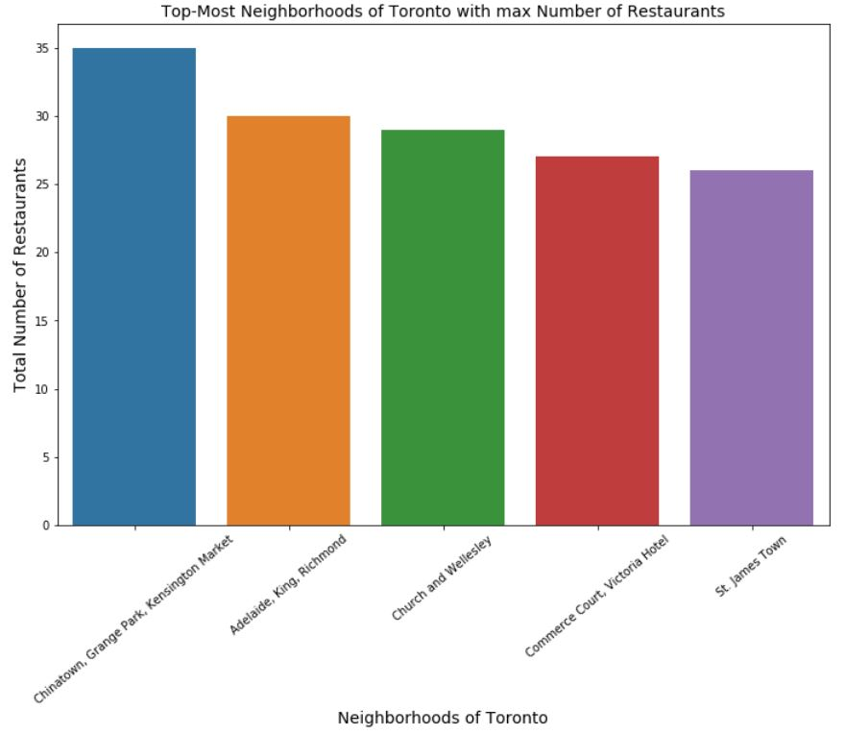
top 5 neighborhoods with maximum number of restaurants

Slide 10
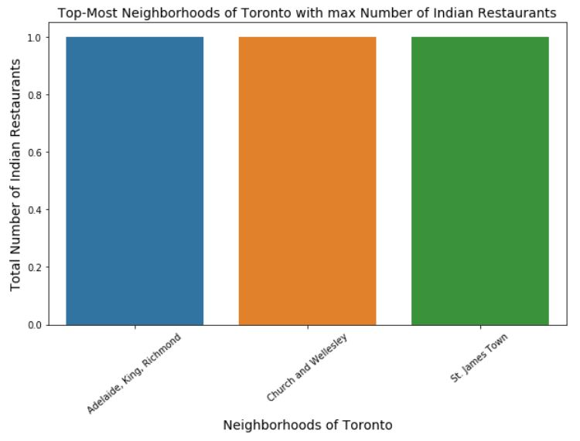
Indian Restaurants in those top 5 neighborhoods

Slide 11
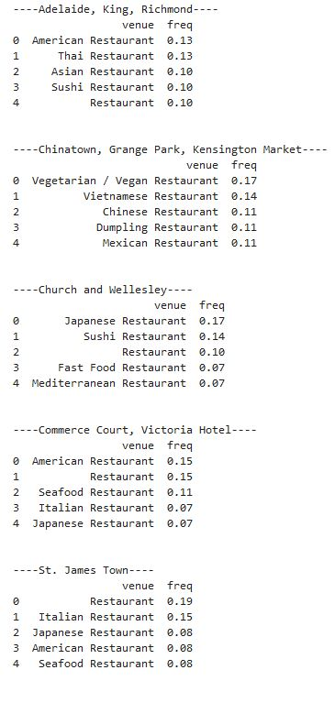
Clustering – top 5 neighborhood along with the top 5 most common venues

Slide 12
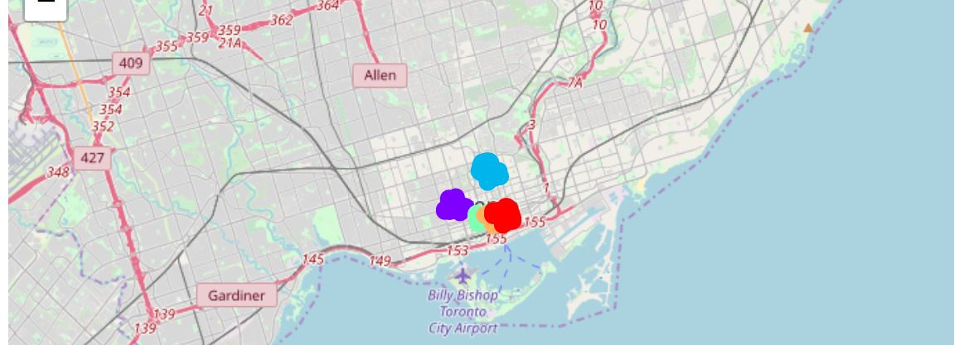
K-Means clustering - Visualization

Slide 13
results
The results of the exploratory data analysis and clustering are:
Japanese Restaurants tops the chart in the top 5 neighborhoods.
Indian Restaurant is one of the top 10 venue in St. James Town and presence in Church and Wellesley and Adelaide, King, Richmond neighborhoods.
Popular restaurants in each neighborhood: 1. St. James Town: Italian, American, Japanese 2. Chinatown, Grange Park, Kensington Market: Vietnamese, Chinese 3. Church and Wellesley: Japanese 4. Adelaide, King, Richmond: American, Thai 5. Commerce Court, Victoria Hotel: American, Thai, Japanese
It is very important to note that Clusters 1, 3 and 4 are the most suitable locations to open a brand Indian Restaurant.

Slide 14
references
Wikipedia page (https://en.wikipedia.org/wiki/List_of_postal_codes_of_Canada:_M) has Postal codes beginning with M are located within the City of Toronto in the province of Ontario.
Latitude and Longitude (the geographical coordinates) of each postal code accessed from http://cocl.us/Geospatial_data
Foursquare API https://developer.foursquare.com/places-api

